Slide 1


Chess piece location and identification using Machine Learning
Work by: Pablo Tomás Campos
Supervised by: Antonio Berlanga

Slide 2

Motivation & Goals
1
Birth and objectives of the project

Slide 3
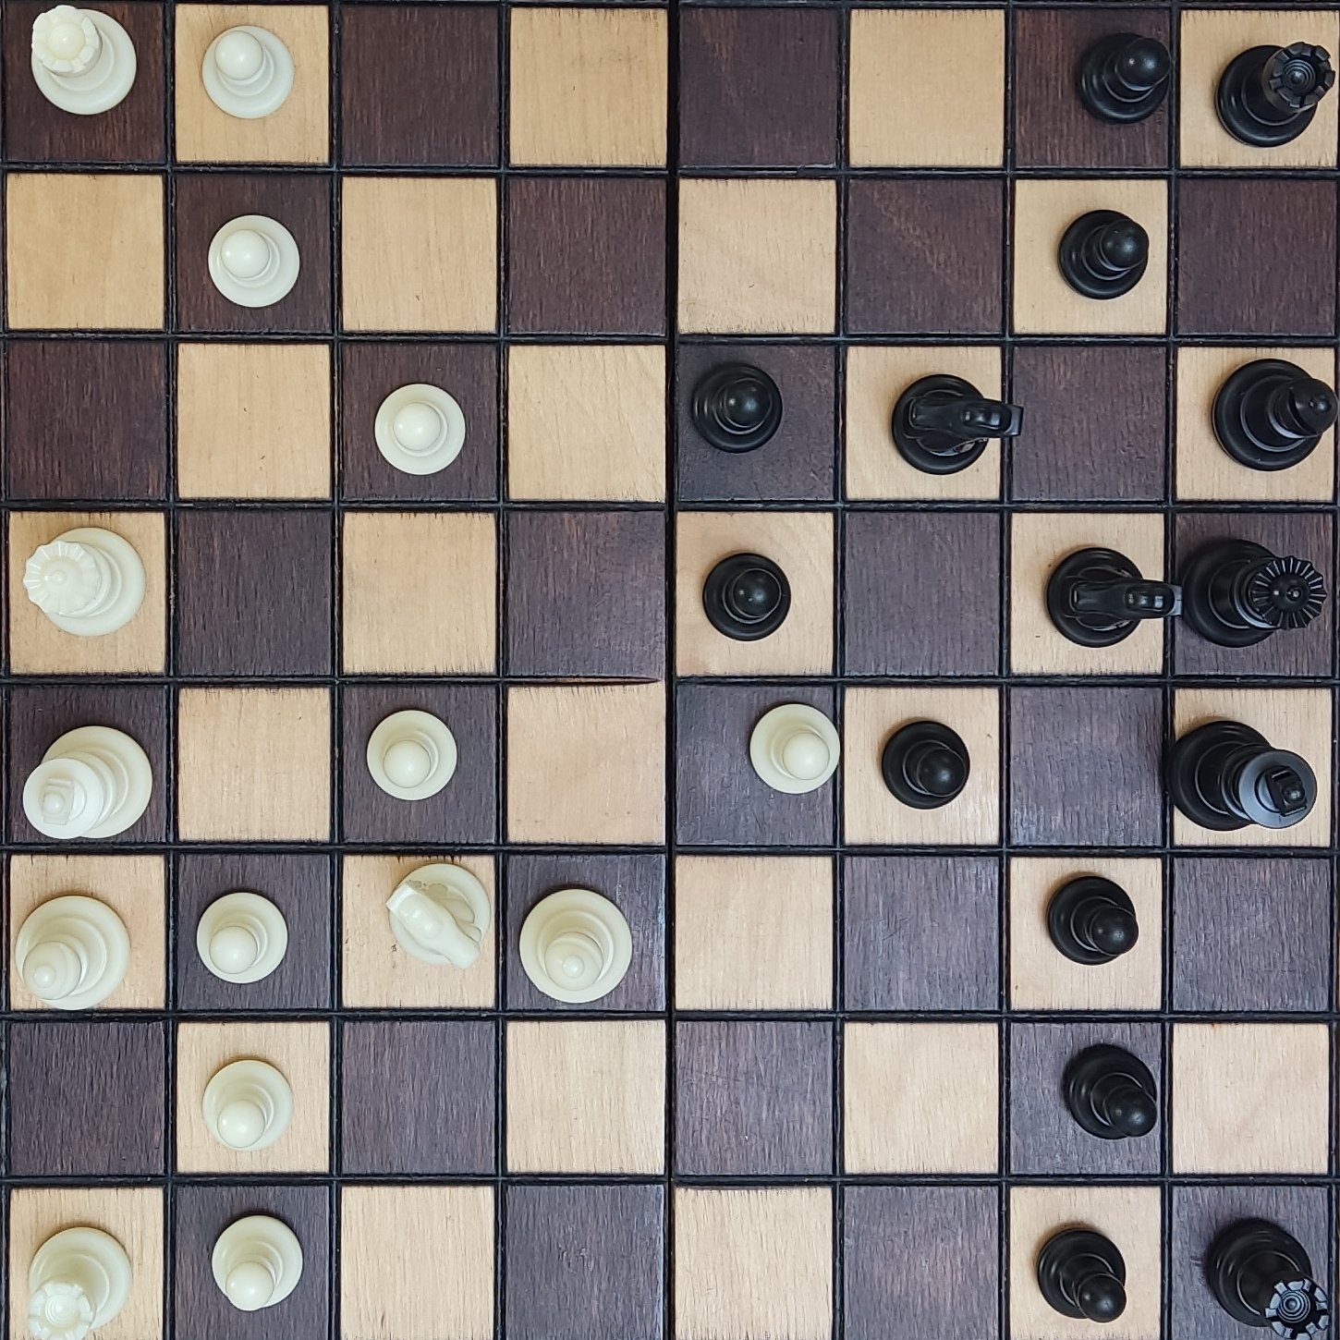
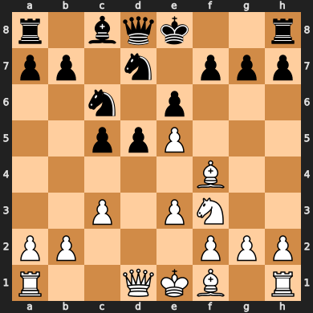
Motivation & Goals

Slide 4

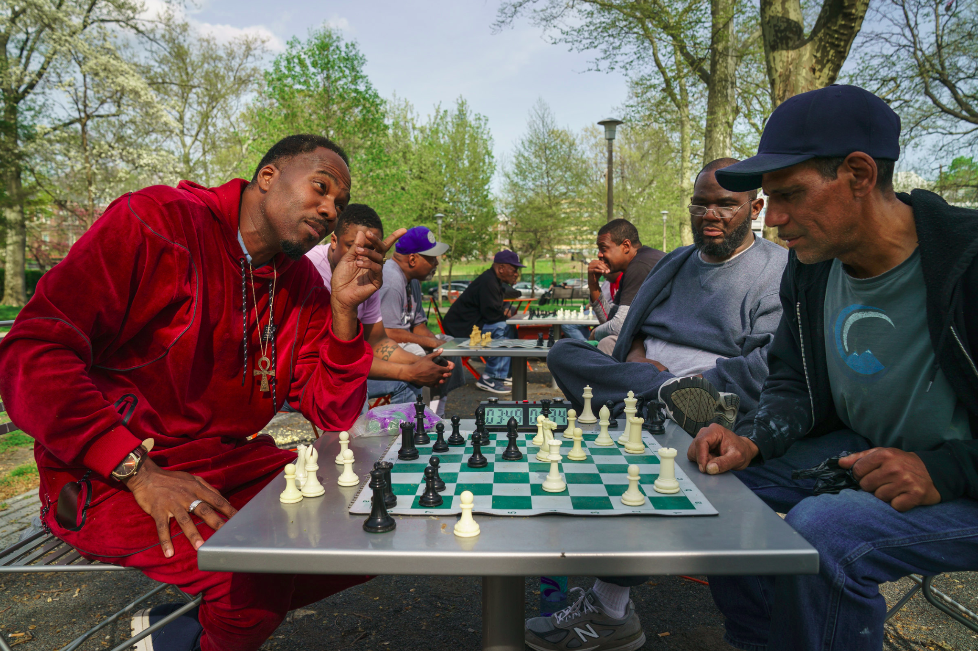
Motivation & Goals

Slide 5
State of the Art
2
Previous work & methodologies

Slide 6
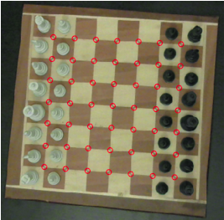
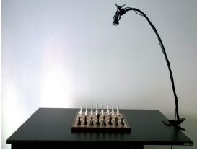
Can Koray, Emre Sümer, 2016 [1]
Methodology
Compare frames between moves
Strengths
Low inference time
Independent from chess set
Requirements
Cold start of game
Board identification
Static camera

Slide 7
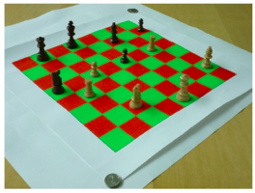
Cheryl Danner, Mai Kafafy, 2016 [2]
Methodology
Color segmentation
Fourier descriptors
Strengths
Low inference time
Rectification of board
Requirements
Board identification
Red & Green board
Dependent on chess set

Slide 8
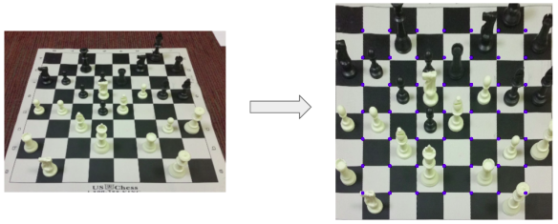
Jialin Ding, 2016 [3]
Methodology
One vs All SVM
Feature selection
Strengths
Excellent results
Rectification of board
Requirements
Board identification
Dependent on chess set

Slide 9
Project Objectives
3
Setting objectives to investigate

Slide 10
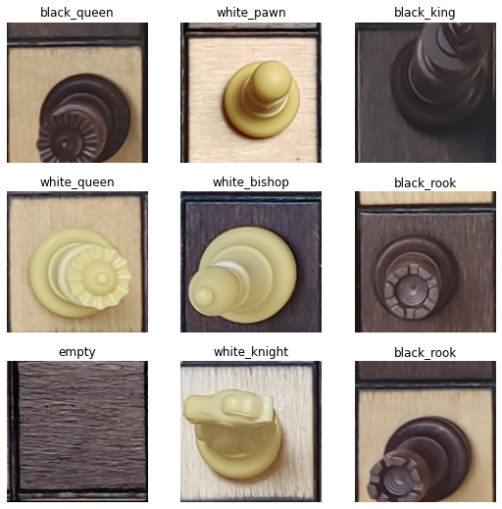
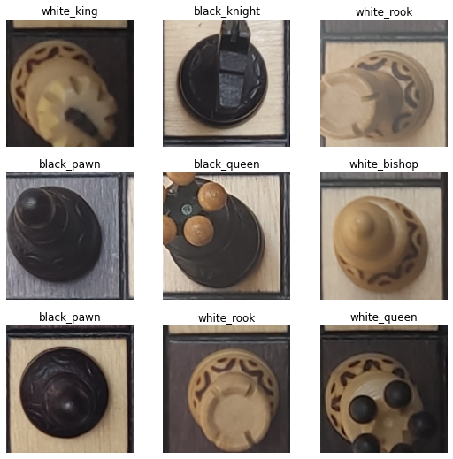
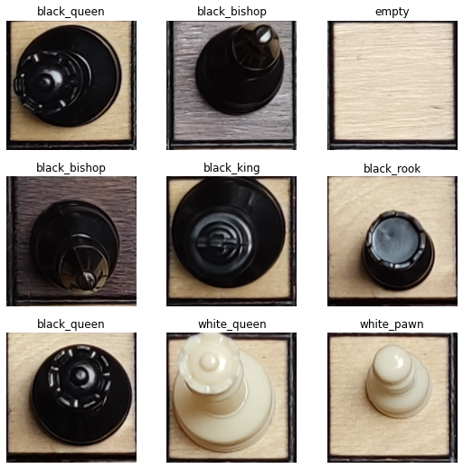
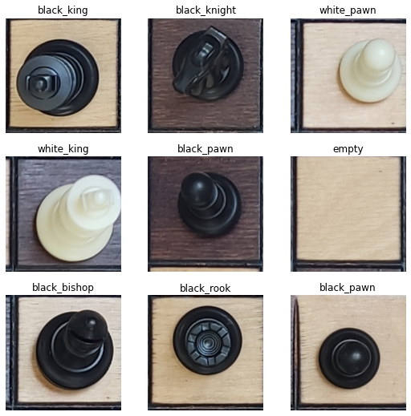
Objective 1: Perform inference on chess sets not seeing during training:
3 Different training chess sets.
1 Independent validation chess set.
3.2k images in total [4].
Training set 1
Training set 2
Training set 3
Validation set

Slide 11
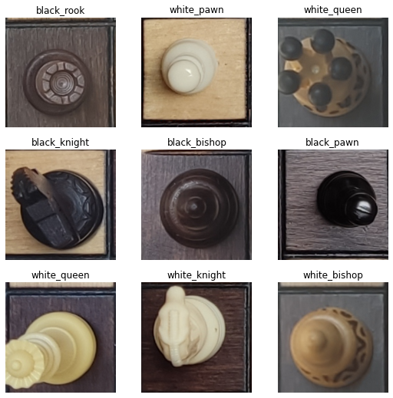
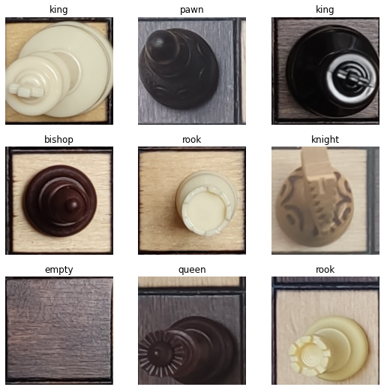
Objective 2: Compare a color agnostic model:
13 labels model: detects both piece type and color.
7 labels model: only detects piece type.
13 labels model
7 labels model

Slide 12
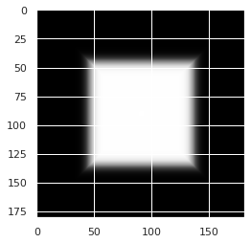
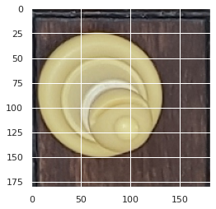
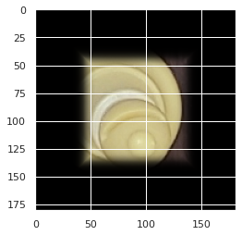
Objective 2: Compare a color agnostic model:
Color will be inferred via k-means.
Apply a mask to all the squares where the 7 label model finds a piece and runs a k-means on the mean pixel value.
Piece mask
Unmasked piece
Masked piece

Slide 13
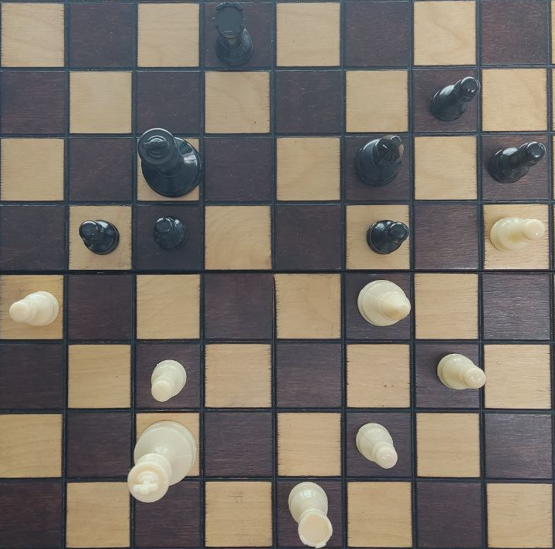
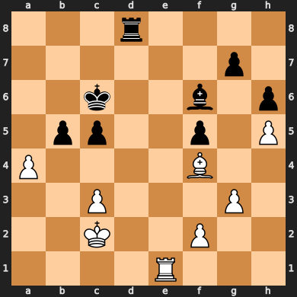
Objective 3: Recreate a chess board position from a bird’s eyes image in digital format.
13 Labels model

Slide 14
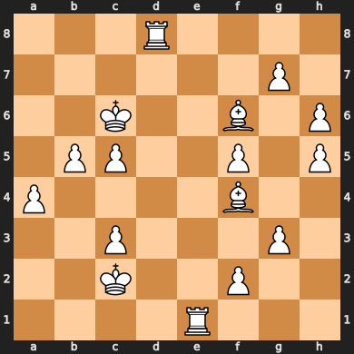
Objective 3: Recreate a chess board position from a bird’s eyes image in digital format.
7 Labels model

Slide 15
Objective 3: Recreate a chess board position from a bird’s eyes image in digital format.
Color Identification

Slide 16
Methodologies
4
Technologies and procedures used

Slide 17

Convolutional Neural Networks: Convolutions

Slide 18
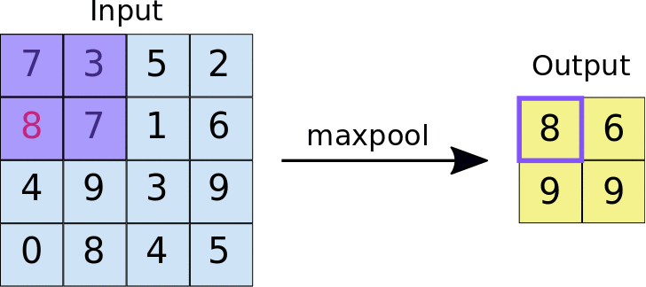
Convolutional Neural Networks: Pooling

Slide 19
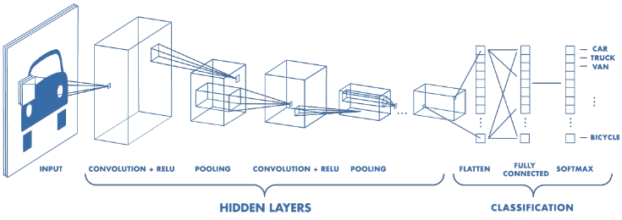
Convolutional Neural Networks

Slide 20
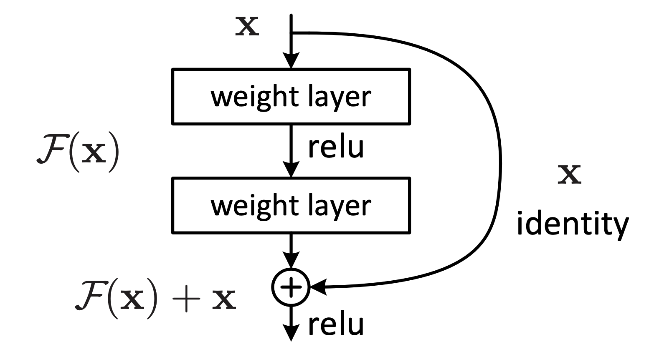
Residual Neural Network: Resnet18 [5]

Slide 21

Transfer Learning: ImageNet [6]

Slide 22
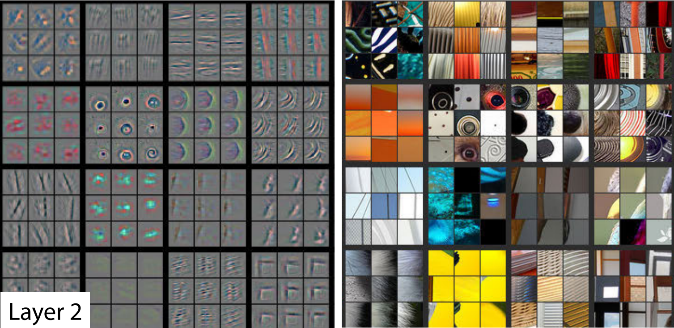
Transfer Learning: Learning Features

Slide 23
Transfer Learning: Fine Tuning
Conserve the base
Randomly Initialized

Slide 24
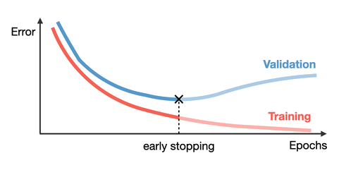
Prevent Overfitting: Early Stopping

Slide 25
Results & Conclusion
5

Slide 26
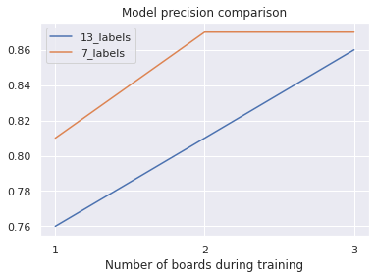
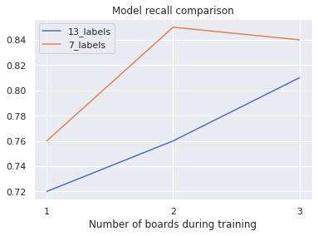
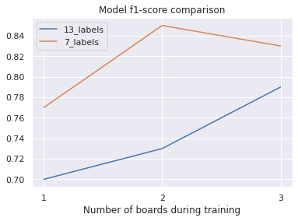
13 vs 7 Labels Approach

Slide 27
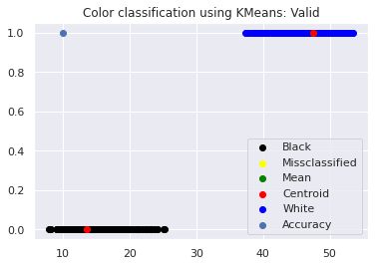
7 Labels Color Identification

Slide 28
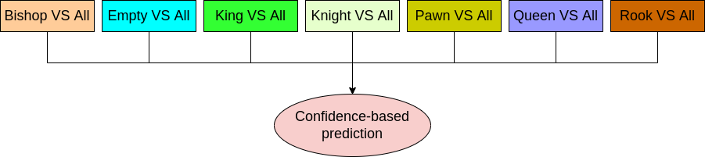
7 Labels One vs All

Slide 29
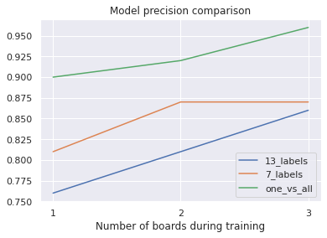
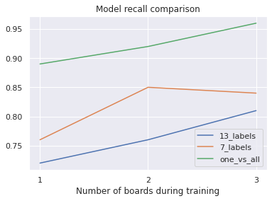
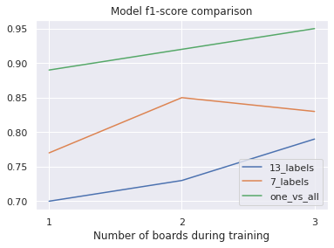
7 Labels One vs All

Slide 30
Board Recreation

Slide 31
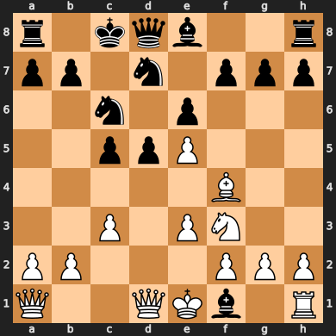
Board Recreation: 13 Labels

Slide 32
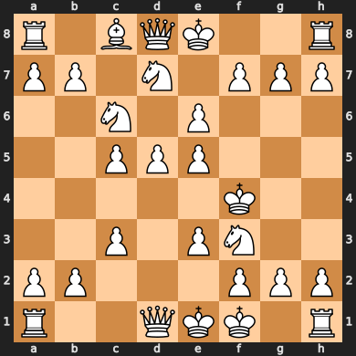
Board Recreation: 7 Labels OVA

Slide 33
Future Work
6
Enhancing inference and usability

Slide 34



Enhancing Inference
Local predictions
Search for better configurations
Consult with chess engines

Slide 35

Enhancing Usability
Programmatic Interface
Mobile/Web App

Slide 36


Any questions?
pablotcampos25@gmail.com
linkedin.com/in/ptcampos
Work by: Pablo Tomás Campos
Supervised by: Antonio Berlanga

Slide 37
Bibliography
C. Koray and E. Sümer, “A Computer Vision System for Chess Game Tracking” 21st Computer Vision Winter Workshop, Rimske Toplice, Slovenia, 2016. [Online]. Available: https://vision.fe.uni-lj.si/cvww2016/proceedings/papers/21.pdf
C. Danner and M. Kafafy, Visual chess recognition, 2016. [Online]. Available: https://web.stanford.edu/class/ee368/Project_Spring_1415/Reports/Danner_Kafafy.pdf
J. Ding, Chessvision: Chess board and piece recognition, 2016. [Online]. Available: https://web.stanford.edu/class/cs231a/prev_projects_2016/CS_231A_Final_Report.pdf
P. T. Campos, Chess piece dataset for image classification, version v1.0.0, Zenodo, Jun. 2022. DOI: 10.5281/zenodo.6656212. [Online]. Available: https://doi.org/10.5281/zenodo.6656212
K. He, X. Zhang, S. Ren, and J. Sun, Deep residual learning for image recognition, 2015. DOI: 10.48550/ARXIV.1512.03385. [Online]. Available: https://arxiv.org/abs/1512.03385
J. Deng, W. Dong, R. Socher, L.-J. Li, K. Li, and L. Fei-Fei, “Imagenet: A large-scale hierarchical image database,” in 2009 IEEE Conference on Computer Vision and Pattern Recognition, 2009, pp. 248–255. DOI: 10.1109/CVPR.2009.5206848

